Slide 1
Chapter 11
I/O Management and Disk Scheduling
Operating Systems:
Internals and Design Principles
Seventh Edition
By William Stallings
Notes:
“Operating Systems: Internal and Design Principles”, 7/e, by William Stallings, Chapter 11 “I/O Management and Disk Scheduling”.

Slide 2

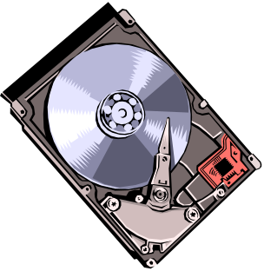
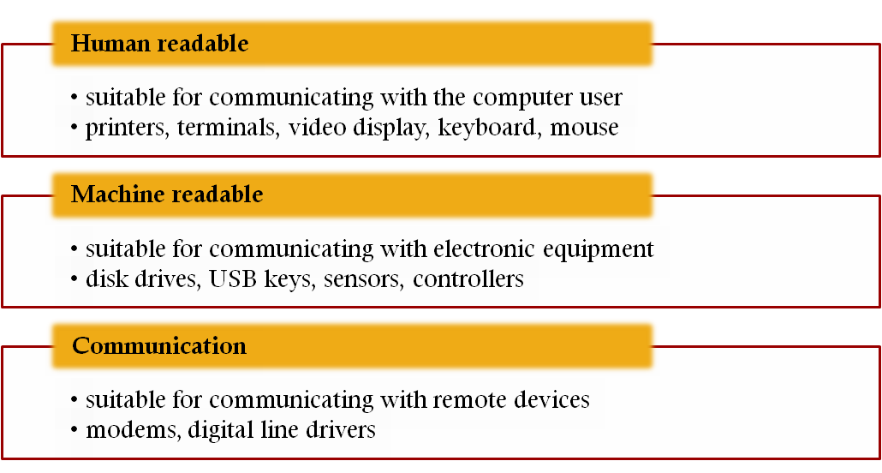
External devices that engage in I/O with computer systems can be grouped into three categories:
Notes:
As was mentioned in Chapter 1 , external devices that engage in I/O with computer
systems can be roughly grouped into three categories:
• Human readable: Suitable for communicating with the computer user.
Examples include printers and terminals, the latter consisting of video display,
keyboard, and perhaps other devices such as a mouse.
Machine readable: Suitable for communicating with electronic equipment.
Examples are disk drives, USB keys, sensors, controllers, and actuators.
• Communication: Suitable for communicating with remote devices. Examples
are digital line drivers and modems.

Slide 3

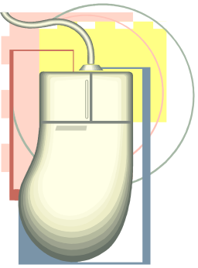
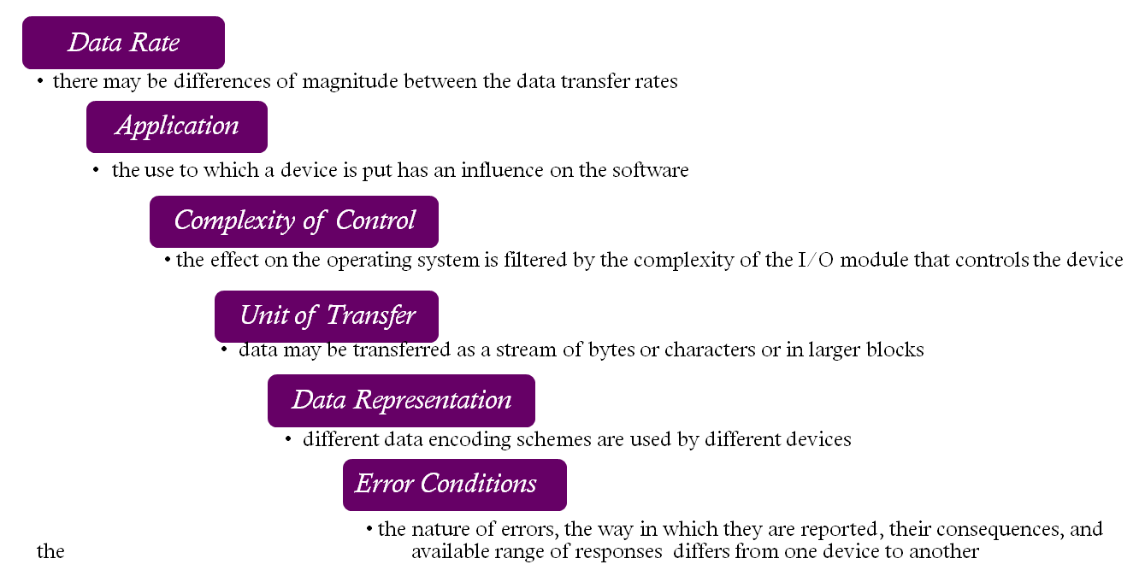
Devices differ in a number of areas:
Notes:
There are great differences across classes and even substantial differences
within each class. Among the key differences are the following:
• Data rate: There may be differences of several orders of magnitude between
the data transfer rates. Figure 11.1 gives some examples.
• Application: The use to which a device is put has an influence on the software
and policies in the operating system and supporting utilities. For example, a
disk used for files requires the support of file management software. A disk
used as a backing store for pages in a virtual memory scheme depends on the
use of virtual memory hardware and software. Furthermore, these applications
have an impact on disk scheduling algorithms (discussed later in this
chapter). As another example, a terminal may be used by an ordinary user or a
system administrator. These uses imply different privilege levels and perhaps
different priorities in the operating system.
• Complexity of control: A printer requires a relatively simple control interface.
A disk is much more complex. The effect of these differences on the operating
system is filtered to some extent by the complexity of the I/O module that
controls the device, as discussed in the next section.
Unit of transfer: Data may be transferred as a stream of bytes or characters
(e.g., terminal I/O) or in larger blocks (e.g., disk I/O).
• Data representation: Different data encoding schemes are used by different
devices, including differences in character code and parity conventions.
• Error conditions: The nature of errors, the way in which they are reported,
their consequences, and the available range of responses differ widely from
one device to another.
This diversity makes a uniform and consistent approach to I/O, both from the
point of view of the operating system and from the point of view of user processes,
difficult to achieve.

Slide 4


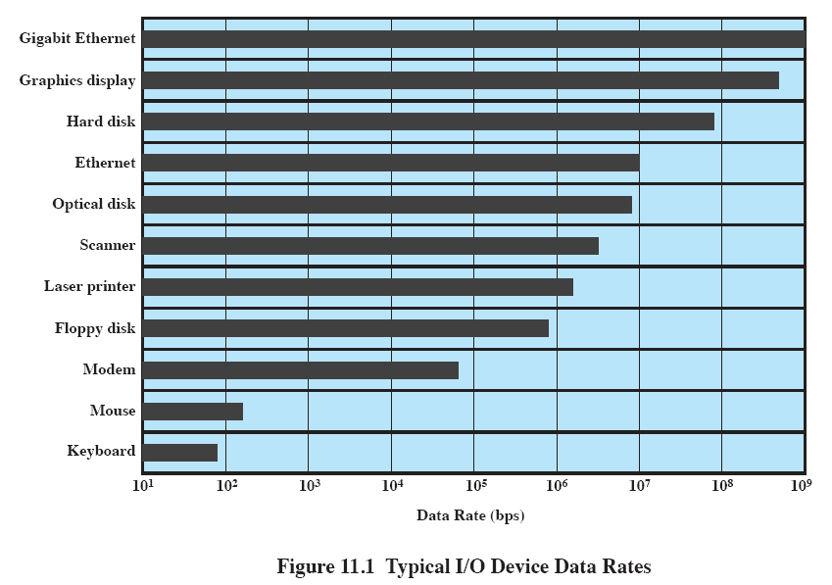
Notes:
There may be differences of several orders of magnitude between the data transfer rates.
Figure 11.1 gives some examples.

Slide 5
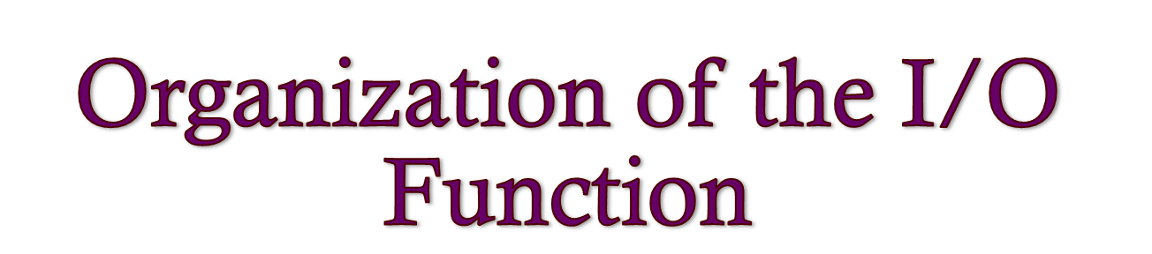
Three techniques for performing I/O are:
Programmed I/O
  the processor issues an I/O command on behalf of a process to an I/O module; that process then busy waits for the operation to be completed before proceeding
Interrupt-driven I/O
  the processor issues an I/O command on behalf of a process
    if non-blocking – processor continues to execute instructions from the process that issued the I/O command
    if blocking – the next instruction the processor executes is from the OS, which will put the current process in a blocked state and schedule another process
Direct Memory Access (DMA)
    a DMA module controls the exchange of data between main memory and an I/O module
Notes:
Appendix C summarizes three techniques for performing I/O:
• Programmed I/O : The processor issues an I/O command, on behalf of a process,
to an I/O module; that process then busy waits for the operation to be completed
before proceeding.
• Interrupt-driven I/O : The processor issues an I/O command on behalf of
a process. There are then two possibilities. If the I/O instruction from the
process is nonblocking, then the processor continues to execute instructions
from the process that issued the I/O command. If the I/O instruction
is blocking, then the next instruction that the processor executes is from
the OS, which will put the current process in a blocked state and schedule
another process.
• Direct memory access (DMA) : A DMA module controls the exchange of data
between main memory and an I/O module. The processor sends a request for
the transfer of a block of data to the DMA module and is interrupted only
after the entire block has been transferred.

Slide 6

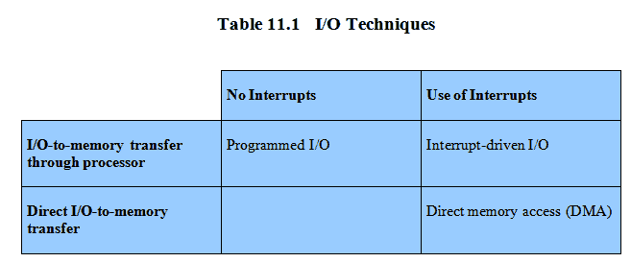
Techniques for Performing I/O
Notes:
Table 11.1 indicates the relationship among these three techniques. In most
computer systems, DMA is the dominant form of transfer that must be supported
by the operating system.

Slide 7

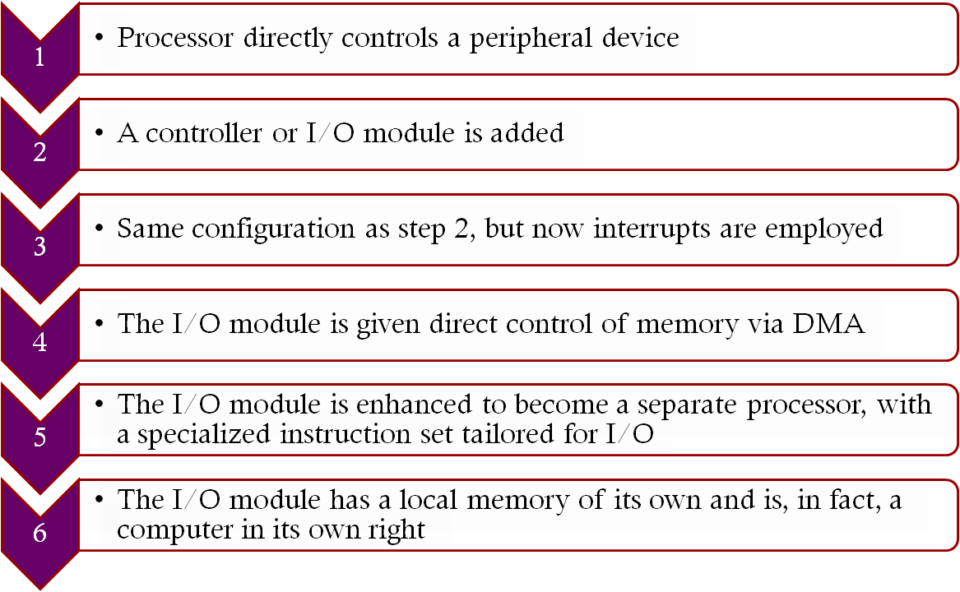

Notes:
As computer systems have evolved, there has been a pattern of increasing
complexity and sophistication of individual components. Nowhere is this more
evident than in the I/O function. The evolutionary steps can be summarized as
Follows:
1. The processor directly controls a peripheral device. This is seen in simple
microprocessor-controlled devices.
2. A controller or I/O module is added. The processor uses programmed I/O
without interrupts. With this step, the processor becomes somewhat divorced
from the specific details of external device interfaces.
3. The same configuration as step 2 is used, but now interrupts are employed. The
processor need not spend time waiting for an I/O operation to be performed,
thus increasing efficiency.
4. The I/O module is given direct control of memory via DMA. It can now move
a block of data to or from memory without involving the processor, except at
the beginning and end of the transfer.
5. The I/O module is enhanced to become a separate processor, with a
specialized instruction set tailored for I/O. The central processing unit
(CPU) directs the I/O processor to execute an I/O program in main
memory. The I/O processor fetches and executes these instructions without
processor intervention. This allows the processor to specify a sequence of
I/O activities and to be interrupted only when the entire sequence has been
performed.
6. The I/O module has a local memory of its own and is, in fact, a computer
in its own right. With this architecture, a large set of I/O devices can be
controlled, with minimal processor involvement. A common use for such an
architecture has been to control communications with interactive terminals.
The I/O processor takes care of most of the tasks involved in controlling the
terminals.
As one proceeds along this evolutionary path, more and more of the I/O
function is performed without processor involvement. The central processor is
increasingly relieved of I/O-related tasks, improving performance. With the last
two steps (5 and 6), a major change occurs with the introduction of the concept of
an I/O module capable of executing a program.
A note about terminology: For all of the modules described in steps 4
through 6, the term direct memory access is appropriate, because all of these
types involve direct control of main memory by the I/O module. Also, the I/O
module in step 5 is often referred to as an I/O channel , and that in step 6 as an
I/O processor ; however, each term is, on occasion, applied to both situations. In
the latter part of this section, we will use the term I/O channel to refer to both
types of I/O modules.

Slide 8
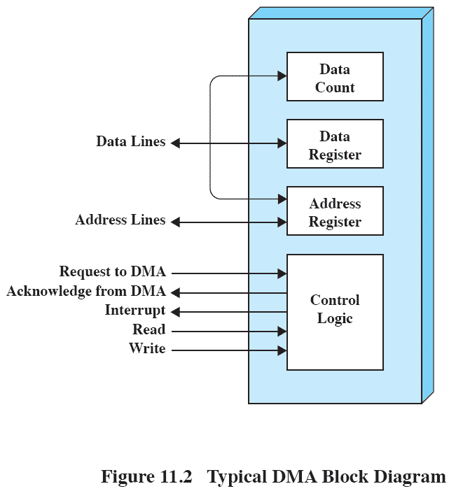


Notes:
Figure 11.2 indicates, in general terms, the DMA logic. The DMA unit is capable of
mimicking the processor and, indeed, of taking over control of the system bus just
like a processor. It needs to do this to transfer data to and from memory over the
system bus.
The DMA technique works as follows. When the processor wishes to read or
write a block of data, it issues a command to the DMA module by sending to the
DMA module the following information:
• Whether a read or write is requested, using the read or write control line
between the processor and the DMA module
• The address of the I/O device involved, communicated on the data lines
• The starting location in memory to read from or write to, communicated on
the data lines and stored by the DMA module in its address register
• The number of words to be read or written, again communicated via the data
lines and stored in the data count register
The processor then continues with other work. It has delegated this I/O operation
to the DMA module. The DMA module transfers the entire block of data, one word
at a time, directly to or from memory, without going through the processor. When the
transfer is complete, the DMA module sends an interrupt signal to the processor. Thus,
the processor is involved only at the beginning and end of the transfer (Figure C.4c).

Slide 9
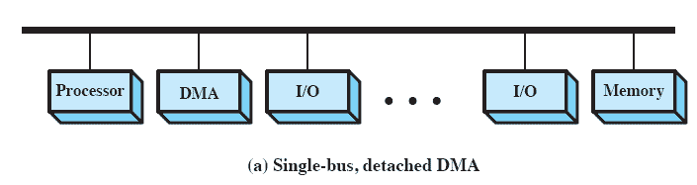

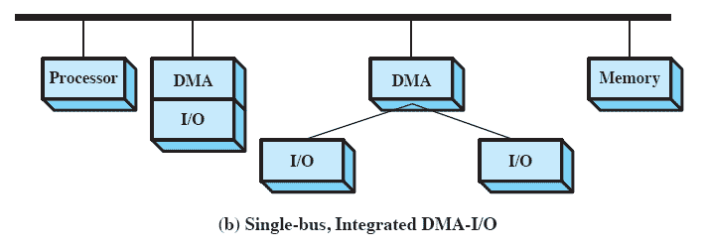

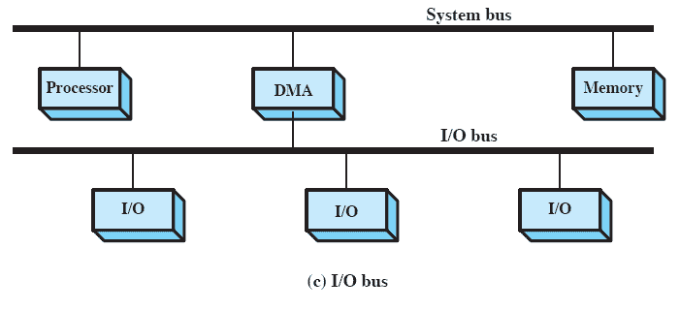

Notes:
The DMA mechanism can be configured in a variety of ways. Some possibilities
are shown in Figure 11.3 . In the first example, all modules share the same
system bus. The DMA module, acting as a surrogate processor, uses programmed
I/O to exchange data between memory and an I/O module through the DMA module.
This configuration, while it may be inexpensive, is clearly inefficient: As with
processor-controlled programmed I/O, each transfer of a word consumes two bus
cycles (transfer request followed by transfer).
The number of required bus cycles can be cut substantially by integrating the
DMA and I/O functions. As Figure 11.3b indicates, this means that there is a path
between the DMA module and one or more I/O modules that does not include the
system bus. The DMA logic may actually be a part of an I/O module, or it may be a
separate module that controls one or more I/O modules. This concept can be taken
one step further by connecting I/O modules to the DMA module using an I/O bus
( Figure 11.3c ). This reduces the number of I/O interfaces in the DMA module
to one and provides for an easily expandable configuration. In all of these cases
( Figure 11.3b and 11.3c ), the system bus that the DMA module shares with the
processor and main memory is used by the DMA module only to exchange data
with memory and to exchange control signals with the processor. The exchange of
data between the DMA and I/O modules takes place off the system bus.

Slide 10

Efficiency
Generality
Major effort in I/O design
Important because I/O operations often form a bottleneck
Most I/O devices are extremely slow compared with main memory and the processor
The area that has received the most attention is disk I/O
Desirable to handle all devices in a uniform manner
Applies to the way processes view I/O devices and the way the operating system manages I/O devices and operations
Diversity of devices makes it difficult to achieve true generality
Use a hierarchical, modular approach to the design of the I/O function
Notes:
Two objectives are paramount in designing the I/O facility: efficiency and generality.
Efficiency is important because I/O operations often form a bottleneck in a
computing system. Looking again at Figure 11.1 , we see that most I/O devices are
extremely slow compared with main memory and the processor. One way to tackle
this problem is multiprogramming, which, as we have seen, allows some processes
to be waiting on I/O operations while another process is executing. However, even
with the vast size of main memory in today’s machines, it will still often be the case
that I/O is not keeping up with the activities of the processor. Swapping is used to
bring in additional ready processes to keep the processor busy, but this in itself is an
I/O operation. Thus, a major effort in I/O design has been schemes for improving
the efficiency of the I/O. The area that has received the most attention, because of
its importance, is disk I/O, and much of this chapter will be devoted to a study of
disk I/O efficiency.
The other major objective is generality . In the interests of simplicity and freedom
from error, it is desirable to handle all devices in a uniform manner. This
statement applies both to the way in which processes view I/O devices and the way
in which the operating system manages I/O devices and operations. Because of the
diversity of device characteristics, it is difficult in practice to achieve true generality.
What can be done is to use a hierarchical, modular approach to the design of
the I/O function. This approach hides most of the details of device I/O in lower level
routines so that user processes and upper levels of the operating system see
devices in terms of general functions, such as read, write, open, close, lock, and
unlock. We turn now to a discussion of this approach.

Slide 11


Functions of the operating system should be separated according to their complexity, their characteristic time scale, and their level of abstraction
Leads to an organization of the operating system into a series of layers
Each layer performs a related subset of the functions required of the operating system
Layers should be defined so that changes in one layer do not require changes in other layers
Notes:
In Chapter 2 , in the discussion of system structure, we emphasized the hierarchical
nature of modern operating systems. The hierarchical philosophy is that the functions
of the operating system should be separated according to their complexity,
their characteristic time scale, and their level of abstraction. Following this approach
leads to an organization of the operating system into a series of layers. Each layer
performs a related subset of the functions required of the operating system. It relies
on the next lower layer to perform more primitive functions and to conceal the
details of those functions. It provides services to the next higher layer. Ideally, the
layers should be defined so that changes in one layer do not require changes in other
layers. Thus we have decomposed one problem into a number of more manageable
subproblems.
In general, lower layers deal with a far shorter time scale. Some parts of the
OS must interact directly with the computer hardware, where events can have a
time scale as brief as a few billionths of a second. At the other end of the spectrum,
parts of the operating system communicate with the user, who issues commands at a
much more leisurely pace, perhaps one every few seconds. The use of a set of layers
conforms nicely to this environment.

Slide 12
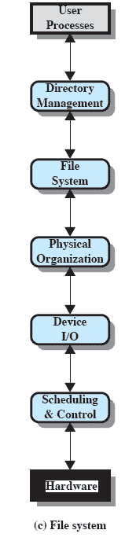
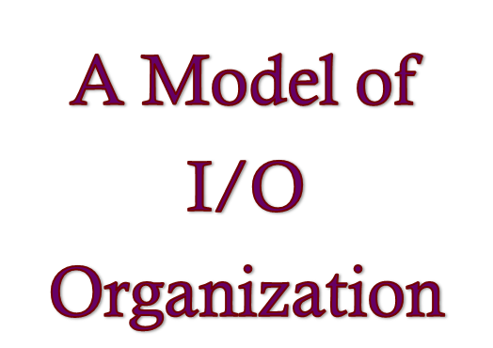
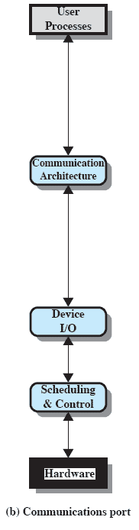
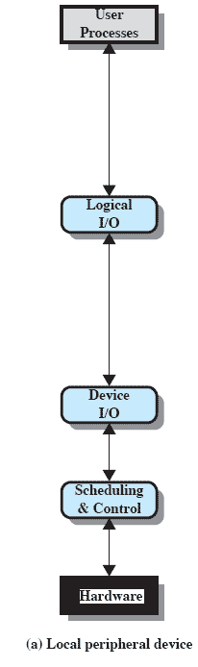

Notes:
Applying this philosophy specifically to the I/O facility leads to the type
of organization suggested by Figure 11.4 . The details of the organization will
depend on the type of device and the application. The three most important
logical structures are presented in the figure. Of course, a particular operating
system may not conform exactly to these structures. However, the general
principles are valid, and most operating systems approach I/O in approximately
this way.
Let us consider the simplest case first, that of a local peripheral device that
communicates in a simple fashion, such as a stream of bytes or records ( Figure 11.4a ).
The following layers are involved:
• Logical I/O : The logical I/O module deals with the device as a logical resource
and is not concerned with the details of actually controlling the device. The
logical I/O module is concerned with managing general I/O functions on behalf
of user processes, allowing them to deal with the device in terms of a device
identifier and simple commands such as open, close, read, and write.
• Device I/O : The requested operations and data (buffered characters, records,
etc.) are converted into appropriate sequences of I/O instructions, channel
commands, and controller orders. Buffering techniques may be used to improve
utilization.
• Scheduling and control: The actual queuing and scheduling of I/O operations
occurs at this layer, as well as the control of the operations. Thus, interrupts
are handled at this layer and I/O status is collected and reported. This is the
layer of software that actually interacts with the I/O module and hence the
device hardware.
For a communications device, the I/O structure ( Figure 11.4b ) looks much the
same as that just described. The principal difference is that the logical I/O module is
replaced by a communications architecture, which may itself consist of a number of
layers. An example is TCP/IP, which is discussed in Chapter 17 .
Figure 11.4c shows a representative structure for managing I/O on a secondary
storage device that supports a file system. The three layers not previously discussed
are as follows:
• Directory management: At this layer, symbolic file names are converted to
identifiers that either reference the file directly or indirectly through a file
descriptor or index table. This layer is also concerned with user operations
that affect the directory of files, such as add, delete, and reorganize.
• File system: This layer deals with the logical structure of files and with the
operations that can be specified by users, such as open, close, read, and write.
Access rights are also managed at this layer.
• Physical organization: Just as virtual memory addresses must be converted
into physical main memory addresses, taking into account the segmentation
and paging structure, logical references to files and records must be converted
to physical secondary storage addresses, taking into account the physical
track and sector structure of the secondary storage device. Allocation of
secondary storage space and main storage buffers is generally treated at this
layer as well.
Because of the importance of the file system, we will spend some time, in this
chapter and the next, looking at its various components. The discussion in this chapter
focuses on the lower three layers, while the upper two layers are examined in
Chapter 12 .

Slide 13

• Logical I/O : The logical I/O module deals with the device as a logical resource
and is not concerned with the details of actually controlling the device.
The logical I/O module is concerned with managing general I/O functions on behalf
of user processes, allowing them to deal with the device in terms of a device identifier and simple commands such as open, close, read, and write.
Notes:
Applying this philosophy specifically to the I/O facility leads to the type
of organization suggested by Figure 11.4 . The details of the organization will
depend on the type of device and the application. The three most important
logical structures are presented in the figure. Of course, a particular operating
system may not conform exactly to these structures. However, the general
principles are valid, and most operating systems approach I/O in approximately
this way.
Let us consider the simplest case first, that of a local peripheral device that
communicates in a simple fashion, such as a stream of bytes or records ( Figure 11.4a ).
The following layers are involved:
• Logical I/O : The logical I/O module deals with the device as a logical resource
and is not concerned with the details of actually controlling the device. The
logical I/O module is concerned with managing general I/O functions on behalf
of user processes, allowing them to deal with the device in terms of a device
identifier and simple commands such as open, close, read, and write.
• Device I/O : The requested operations and data (buffered characters, records,
etc.) are converted into appropriate sequences of I/O instructions, channel
commands, and controller orders. Buffering techniques may be used to improve
utilization.
• Scheduling and control: The actual queuing and scheduling of I/O operations
occurs at this layer, as well as the control of the operations. Thus, interrupts
are handled at this layer and I/O status is collected and reported. This is the
layer of software that actually interacts with the I/O module and hence the
device hardware.
For a communications device, the I/O structure ( Figure 11.4b ) looks much the
same as that just described. The principal difference is that the logical I/O module is
replaced by a communications architecture, which may itself consist of a number of
layers. An example is TCP/IP, which is discussed in Chapter 17 .
Figure 11.4c shows a representative structure for managing I/O on a secondary
storage device that supports a file system. The three layers not previously discussed
are as follows:
• Directory management: At this layer, symbolic file names are converted to
identifiers that either reference the file directly or indirectly through a file
descriptor or index table. This layer is also concerned with user operations
that affect the directory of files, such as add, delete, and reorganize.
• File system: This layer deals with the logical structure of files and with the
operations that can be specified by users, such as open, close, read, and write.
Access rights are also managed at this layer.
• Physical organization: Just as virtual memory addresses must be converted
into physical main memory addresses, taking into account the segmentation
and paging structure, logical references to files and records must be converted
to physical secondary storage addresses, taking into account the physical
track and sector structure of the secondary storage device. Allocation of
secondary storage space and main storage buffers is generally treated at this
layer as well.
Because of the importance of the file system, we will spend some time, in this
chapter and the next, looking at its various components. The discussion in this chapter
focuses on the lower three layers, while the upper two layers are examined in
Chapter 12 .

Slide 14
• Device I/O : The requested operations and data (buffered characters, records,
etc.) are converted into appropriate sequences of I/O instructions, channel commands, and controller orders.
Buffering techniques may be used to improve utilization.
Notes:
Applying this philosophy specifically to the I/O facility leads to the type
of organization suggested by Figure 11.4 . The details of the organization will
depend on the type of device and the application. The three most important
logical structures are presented in the figure. Of course, a particular operating
system may not conform exactly to these structures. However, the general
principles are valid, and most operating systems approach I/O in approximately
this way.
Let us consider the simplest case first, that of a local peripheral device that
communicates in a simple fashion, such as a stream of bytes or records ( Figure 11.4a ).
The following layers are involved:
• Logical I/O : The logical I/O module deals with the device as a logical resource
and is not concerned with the details of actually controlling the device. The
logical I/O module is concerned with managing general I/O functions on behalf
of user processes, allowing them to deal with the device in terms of a device
identifier and simple commands such as open, close, read, and write.
• Device I/O : The requested operations and data (buffered characters, records,
etc.) are converted into appropriate sequences of I/O instructions, channel
commands, and controller orders. Buffering techniques may be used to improve
utilization.
• Scheduling and control: The actual queuing and scheduling of I/O operations
occurs at this layer, as well as the control of the operations. Thus, interrupts
are handled at this layer and I/O status is collected and reported. This is the
layer of software that actually interacts with the I/O module and hence the
device hardware.
For a communications device, the I/O structure ( Figure 11.4b ) looks much the
same as that just described. The principal difference is that the logical I/O module is
replaced by a communications architecture, which may itself consist of a number of
layers. An example is TCP/IP, which is discussed in Chapter 17 .
Figure 11.4c shows a representative structure for managing I/O on a secondary
storage device that supports a file system. The three layers not previously discussed
are as follows:
• Directory management: At this layer, symbolic file names are converted to
identifiers that either reference the file directly or indirectly through a file
descriptor or index table. This layer is also concerned with user operations
that affect the directory of files, such as add, delete, and reorganize.
• File system: This layer deals with the logical structure of files and with the
operations that can be specified by users, such as open, close, read, and write.
Access rights are also managed at this layer.
• Physical organization: Just as virtual memory addresses must be converted
into physical main memory addresses, taking into account the segmentation
and paging structure, logical references to files and records must be converted
to physical secondary storage addresses, taking into account the physical
track and sector structure of the secondary storage device. Allocation of
secondary storage space and main storage buffers is generally treated at this
layer as well.
Because of the importance of the file system, we will spend some time, in this
chapter and the next, looking at its various components. The discussion in this chapter
focuses on the lower three layers, while the upper two layers are examined in
Chapter 12 .

Slide 15
• Scheduling and control: The actual queuing and scheduling of I/O operations
occurs at this layer, as well as the control of the operations.
Thus, interrupts are handled at this layer and I/O status is collected and reported.
This is the layer of software that actually interacts with the I/O module and hence the
device hardware.
Notes:
Applying this philosophy specifically to the I/O facility leads to the type
of organization suggested by Figure 11.4 . The details of the organization will
depend on the type of device and the application. The three most important
logical structures are presented in the figure. Of course, a particular operating
system may not conform exactly to these structures. However, the general
principles are valid, and most operating systems approach I/O in approximately
this way.
Let us consider the simplest case first, that of a local peripheral device that
communicates in a simple fashion, such as a stream of bytes or records ( Figure 11.4a ).
The following layers are involved:
• Logical I/O : The logical I/O module deals with the device as a logical resource
and is not concerned with the details of actually controlling the device. The
logical I/O module is concerned with managing general I/O functions on behalf
of user processes, allowing them to deal with the device in terms of a device
identifier and simple commands such as open, close, read, and write.
• Device I/O : The requested operations and data (buffered characters, records,
etc.) are converted into appropriate sequences of I/O instructions, channel
commands, and controller orders. Buffering techniques may be used to improve
utilization.
• Scheduling and control: The actual queuing and scheduling of I/O operations
occurs at this layer, as well as the control of the operations. Thus, interrupts
are handled at this layer and I/O status is collected and reported. This is the
layer of software that actually interacts with the I/O module and hence the
device hardware.
For a communications device, the I/O structure ( Figure 11.4b ) looks much the
same as that just described. The principal difference is that the logical I/O module is
replaced by a communications architecture, which may itself consist of a number of
layers. An example is TCP/IP, which is discussed in Chapter 17 .
Figure 11.4c shows a representative structure for managing I/O on a secondary
storage device that supports a file system. The three layers not previously discussed
are as follows:
• Directory management: At this layer, symbolic file names are converted to
identifiers that either reference the file directly or indirectly through a file
descriptor or index table. This layer is also concerned with user operations
that affect the directory of files, such as add, delete, and reorganize.
• File system: This layer deals with the logical structure of files and with the
operations that can be specified by users, such as open, close, read, and write.
Access rights are also managed at this layer.
• Physical organization: Just as virtual memory addresses must be converted
into physical main memory addresses, taking into account the segmentation
and paging structure, logical references to files and records must be converted
to physical secondary storage addresses, taking into account the physical
track and sector structure of the secondary storage device. Allocation of
secondary storage space and main storage buffers is generally treated at this
layer as well.
Because of the importance of the file system, we will spend some time, in this
chapter and the next, looking at its various components. The discussion in this chapter
focuses on the lower three layers, while the upper two layers are examined in
Chapter 12 .

Slide 16
Notes:
Applying this philosophy specifically to the I/O facility leads to the type
of organization suggested by Figure 11.4 . The details of the organization will
depend on the type of device and the application. The three most important
logical structures are presented in the figure. Of course, a particular operating
system may not conform exactly to these structures. However, the general
principles are valid, and most operating systems approach I/O in approximately
this way.
Let us consider the simplest case first, that of a local peripheral device that
communicates in a simple fashion, such as a stream of bytes or records ( Figure 11.4a ).
The following layers are involved:
• Logical I/O : The logical I/O module deals with the device as a logical resource
and is not concerned with the details of actually controlling the device. The
logical I/O module is concerned with managing general I/O functions on behalf
of user processes, allowing them to deal with the device in terms of a device
identifier and simple commands such as open, close, read, and write.
• Device I/O : The requested operations and data (buffered characters, records,
etc.) are converted into appropriate sequences of I/O instructions, channel
commands, and controller orders. Buffering techniques may be used to improve
utilization.
• Scheduling and control: The actual queuing and scheduling of I/O operations
occurs at this layer, as well as the control of the operations. Thus, interrupts
are handled at this layer and I/O status is collected and reported. This is the
layer of software that actually interacts with the I/O module and hence the
device hardware.
For a communications device, the I/O structure ( Figure 11.4b ) looks much the
same as that just described. The principal difference is that the logical I/O module is
replaced by a communications architecture, which may itself consist of a number of
layers. An example is TCP/IP, which is discussed in Chapter 17 .
Figure 11.4c shows a representative structure for managing I/O on a secondary
storage device that supports a file system. The three layers not previously discussed
are as follows:
• Directory management: At this layer, symbolic file names are converted to
identifiers that either reference the file directly or indirectly through a file
descriptor or index table. This layer is also concerned with user operations
that affect the directory of files, such as add, delete, and reorganize.
• File system: This layer deals with the logical structure of files and with the
operations that can be specified by users, such as open, close, read, and write.
Access rights are also managed at this layer.
• Physical organization: Just as virtual memory addresses must be converted
into physical main memory addresses, taking into account the segmentation
and paging structure, logical references to files and records must be converted
to physical secondary storage addresses, taking into account the physical
track and sector structure of the secondary storage device. Allocation of
secondary storage space and main storage buffers is generally treated at this
layer as well.
Because of the importance of the file system, we will spend some time, in this
chapter and the next, looking at its various components. The discussion in this chapter
focuses on the lower three layers, while the upper two layers are examined in
Chapter 12 .

Slide 17

• Directory management: At this layer, symbolic file names are converted to
identifiers that either reference the file directly or indirectly through a file descriptor or index table.
This layer is also concerned with user operations
that affect the directory of files, such as add, delete, and reorganize.
Notes:
Applying this philosophy specifically to the I/O facility leads to the type
of organization suggested by Figure 11.4 . The details of the organization will
depend on the type of device and the application. The three most important
logical structures are presented in the figure. Of course, a particular operating
system may not conform exactly to these structures. However, the general
principles are valid, and most operating systems approach I/O in approximately
this way.
Let us consider the simplest case first, that of a local peripheral device that
communicates in a simple fashion, such as a stream of bytes or records ( Figure 11.4a ).
The following layers are involved:
• Logical I/O : The logical I/O module deals with the device as a logical resource
and is not concerned with the details of actually controlling the device. The
logical I/O module is concerned with managing general I/O functions on behalf
of user processes, allowing them to deal with the device in terms of a device
identifier and simple commands such as open, close, read, and write.
• Device I/O : The requested operations and data (buffered characters, records,
etc.) are converted into appropriate sequences of I/O instructions, channel
commands, and controller orders. Buffering techniques may be used to improve
utilization.
• Scheduling and control: The actual queuing and scheduling of I/O operations
occurs at this layer, as well as the control of the operations. Thus, interrupts
are handled at this layer and I/O status is collected and reported. This is the
layer of software that actually interacts with the I/O module and hence the
device hardware.
For a communications device, the I/O structure ( Figure 11.4b ) looks much the
same as that just described. The principal difference is that the logical I/O module is
replaced by a communications architecture, which may itself consist of a number of
layers. An example is TCP/IP, which is discussed in Chapter 17 .
Figure 11.4c shows a representative structure for managing I/O on a secondary
storage device that supports a file system. The three layers not previously discussed
are as follows:
• Directory management: At this layer, symbolic file names are converted to
identifiers that either reference the file directly or indirectly through a file
descriptor or index table. This layer is also concerned with user operations
that affect the directory of files, such as add, delete, and reorganize.
• File system: This layer deals with the logical structure of files and with the
operations that can be specified by users, such as open, close, read, and write.
Access rights are also managed at this layer.
• Physical organization: Just as virtual memory addresses must be converted
into physical main memory addresses, taking into account the segmentation
and paging structure, logical references to files and records must be converted
to physical secondary storage addresses, taking into account the physical
track and sector structure of the secondary storage device. Allocation of
secondary storage space and main storage buffers is generally treated at this
layer as well.
Because of the importance of the file system, we will spend some time, in this
chapter and the next, looking at its various components. The discussion in this chapter
focuses on the lower three layers, while the upper two layers are examined in
Chapter 12 .

Slide 18
• File system: This layer deals with the logical structure of files and with the
operations that can be specified by users, such as open, close, read, and write.
Access rights are also managed at this layer.
Notes:
Applying this philosophy specifically to the I/O facility leads to the type
of organization suggested by Figure 11.4 . The details of the organization will
depend on the type of device and the application. The three most important
logical structures are presented in the figure. Of course, a particular operating
system may not conform exactly to these structures. However, the general
principles are valid, and most operating systems approach I/O in approximately
this way.
Let us consider the simplest case first, that of a local peripheral device that
communicates in a simple fashion, such as a stream of bytes or records ( Figure 11.4a ).
The following layers are involved:
• Logical I/O : The logical I/O module deals with the device as a logical resource
and is not concerned with the details of actually controlling the device. The
logical I/O module is concerned with managing general I/O functions on behalf
of user processes, allowing them to deal with the device in terms of a device
identifier and simple commands such as open, close, read, and write.
• Device I/O : The requested operations and data (buffered characters, records,
etc.) are converted into appropriate sequences of I/O instructions, channel
commands, and controller orders. Buffering techniques may be used to improve
utilization.
• Scheduling and control: The actual queuing and scheduling of I/O operations
occurs at this layer, as well as the control of the operations. Thus, interrupts
are handled at this layer and I/O status is collected and reported. This is the
layer of software that actually interacts with the I/O module and hence the
device hardware.
For a communications device, the I/O structure ( Figure 11.4b ) looks much the
same as that just described. The principal difference is that the logical I/O module is
replaced by a communications architecture, which may itself consist of a number of
layers. An example is TCP/IP, which is discussed in Chapter 17 .
Figure 11.4c shows a representative structure for managing I/O on a secondary
storage device that supports a file system. The three layers not previously discussed
are as follows:
• Directory management: At this layer, symbolic file names are converted to
identifiers that either reference the file directly or indirectly through a file
descriptor or index table. This layer is also concerned with user operations
that affect the directory of files, such as add, delete, and reorganize.
• File system: This layer deals with the logical structure of files and with the
operations that can be specified by users, such as open, close, read, and write.
Access rights are also managed at this layer.
• Physical organization: Just as virtual memory addresses must be converted
into physical main memory addresses, taking into account the segmentation
and paging structure, logical references to files and records must be converted
to physical secondary storage addresses, taking into account the physical
track and sector structure of the secondary storage device. Allocation of
secondary storage space and main storage buffers is generally treated at this
layer as well.
Because of the importance of the file system, we will spend some time, in this
chapter and the next, looking at its various components. The discussion in this chapter
focuses on the lower three layers, while the upper two layers are examined in
Chapter 12 .

Slide 19
• Physical organization: Just as virtual memory addresses must be converted into physical main memory addresses, taking into account the segmentation and paging structure, logical references to files and records must be converted to physical secondary storage addresses, taking into account the physical
track and sector structure of the secondary storage device.
Allocation of secondary storage space and main storage buffers is generally treated at this layer as well.
Notes:
Applying this philosophy specifically to the I/O facility leads to the type
of organization suggested by Figure 11.4 . The details of the organization will
depend on the type of device and the application. The three most important
logical structures are presented in the figure. Of course, a particular operating
system may not conform exactly to these structures. However, the general
principles are valid, and most operating systems approach I/O in approximately
this way.
Let us consider the simplest case first, that of a local peripheral device that
communicates in a simple fashion, such as a stream of bytes or records ( Figure 11.4a ).
The following layers are involved:
• Logical I/O : The logical I/O module deals with the device as a logical resource
and is not concerned with the details of actually controlling the device. The
logical I/O module is concerned with managing general I/O functions on behalf
of user processes, allowing them to deal with the device in terms of a device
identifier and simple commands such as open, close, read, and write.
• Device I/O : The requested operations and data (buffered characters, records,
etc.) are converted into appropriate sequences of I/O instructions, channel
commands, and controller orders. Buffering techniques may be used to improve
utilization.
• Scheduling and control: The actual queuing and scheduling of I/O operations
occurs at this layer, as well as the control of the operations. Thus, interrupts
are handled at this layer and I/O status is collected and reported. This is the
layer of software that actually interacts with the I/O module and hence the
device hardware.
For a communications device, the I/O structure ( Figure 11.4b ) looks much the
same as that just described. The principal difference is that the logical I/O module is
replaced by a communications architecture, which may itself consist of a number of
layers. An example is TCP/IP, which is discussed in Chapter 17 .
Figure 11.4c shows a representative structure for managing I/O on a secondary
storage device that supports a file system. The three layers not previously discussed
are as follows:
• Directory management: At this layer, symbolic file names are converted to
identifiers that either reference the file directly or indirectly through a file
descriptor or index table. This layer is also concerned with user operations
that affect the directory of files, such as add, delete, and reorganize.
• File system: This layer deals with the logical structure of files and with the
operations that can be specified by users, such as open, close, read, and write.
Access rights are also managed at this layer.
• Physical organization: Just as virtual memory addresses must be converted
into physical main memory addresses, taking into account the segmentation
and paging structure, logical references to files and records must be converted
to physical secondary storage addresses, taking into account the physical
track and sector structure of the secondary storage device. Allocation of
secondary storage space and main storage buffers is generally treated at this
layer as well.
Because of the importance of the file system, we will spend some time, in this
chapter and the next, looking at its various components. The discussion in this chapter
focuses on the lower three layers, while the upper two layers are examined in
Chapter 12 .

Slide 20

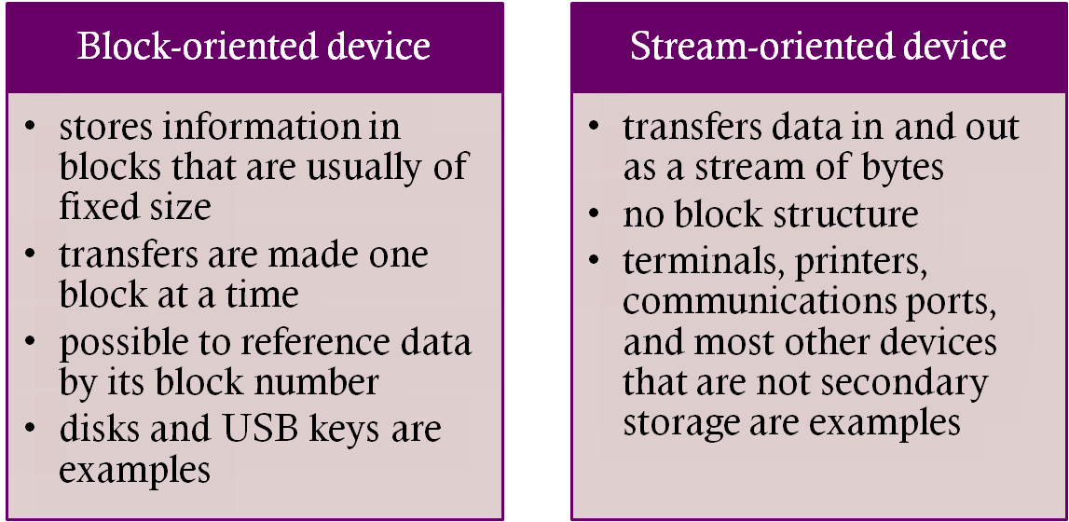
Perform input transfers in advance of requests being made and perform output transfers some time after the request is made
Notes:
The same considerations apply to an output operation. If a block is being
transferred from a user process area directly to an I/O module, then the process is
blocked during the transfer and the process may not be swapped out.
To avoid these overheads and inefficiencies, it is sometimes convenient to
perform input transfers in advance of requests being made and to perform output
transfers some time after the request is made. This technique is known as buffering.
In this section, we look at some of the buffering schemes that are supported by
operating systems to improve the performance of the system.
In discussing the various approaches to buffering, it is sometimes important
to make a distinction between two types of I/O devices: block oriented and stream
oriented. A block-oriented device stores information in blocks that are usually of
fixed size, and transfers are made one block at a time. Generally, it is possible to
reference data by its block number. Disks and USB keys are examples of block oriented
devices. A stream-oriented device transfers data in and out as a stream of
bytes, with no block structure. Terminals, printers, communications ports, mouse
and other pointing devices, and most other devices that are not secondary storage
are stream oriented.

Slide 21
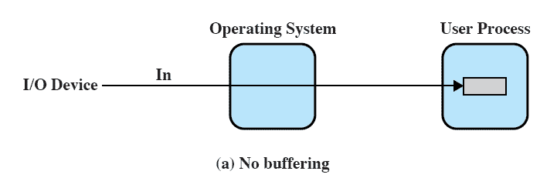
No Buffer
Without a buffer, the OS directly accesses the device when it needs
Notes:
Without a buffer, the OS directly accesses the device when it needs to.

Slide 22
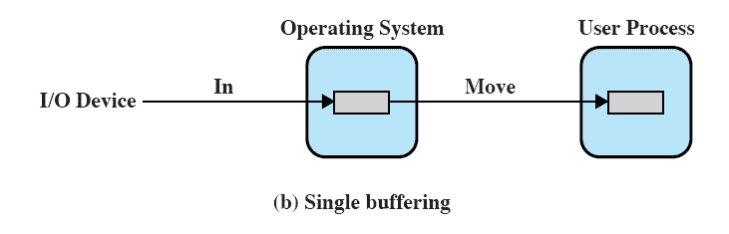
Single Buffer
Operating system assigns a buffer in main memory for an I/O request
Notes:
The simplest type of support that the operating system can provide is single buffering
( Figure 11.5b ). When a user process issues an I/O request, the OS assigns a buffer in
the system portion of main memory to the operation.
In the case of line-at-a-time I/O, the buffer can be used to hold a single line.
The user process is suspended during input, awaiting the arrival of the entire line.
For output, the user process can place a line of output in the buffer and continue
processing. It need not be suspended unless it has a second line of output to send
before the buffer is emptied from the first output operation. In the case of byte-at-a-time
I/O, the interaction between the OS and the user process follows the producer/
consumer model discussed in Chapter 5 .

Slide 23

Input transfers are made to the system buffer
When the transfer is complete, the process moves the block into user space and immediately requests another block.
Reading ahead/anticipated input
    is done in the expectation that the block will eventually be needed
    when the transfer is complete, the process moves the block into user space and immediately requests another block
    Generally provides a speedup compared to the lack of system buffering
    Disadvantages:
    complicates the logic in the operating system
    swapping logic is also affected
Notes:
For block-oriented devices, the single buffering scheme can be described
as follows: Input transfers are made to the system buffer. When the transfer is
complete, the process moves the block into user space and immediately requests
another block. This is called reading ahead, or anticipated input; it is done in the
expectation that the block will eventually be needed. For many types of computation,
this is a reasonable assumption most of the time because data are usually
accessed sequentially. Only at the end of a sequence of processing will a block be
read in unnecessarily.
This approach will generally provide a speedup compared to the lack of system
buffering. The user process can be processing one block of data while the next block
is being read in. The OS is able to swap the process out because the input operation
is taking place in system memory rather than user process memory. This technique
does, however, complicate the logic in the operating system. The OS must keep
track of the assignment of system buffers to user processes. The swapping logic is
also affected: If the I/O operation involves the same disk that is used for swapping,
it hardly makes sense to queue disk writes to the same device for swapping the process
out. This attempt to swap the process and release main memory will itself not
begin until after the I/O operation finishes, at which time swapping the process to
disk may no longer be appropriate.
Similar considerations apply to block-oriented output. When data are being
transmitted to a device, they are first copied from the user space into the system
buffer, from which they will ultimately be written. The requesting process is now
free to continue or to be swapped as necessary.
[KNUT97] suggests a crude but informative performance comparison between
single buffering and no buffering. Suppose that T is the time required to input one
block and that C is the computation time that intervenes between input requests.
Without buffering, the execution time per block is essentially T + C . With a single
buffer, the time is max [C, T] + M , where M is the time required to move the data
from the system buffer to user memory. In most cases, execution time per block is
substantially less with a single buffer compared to no buffer.

Slide 24


Line-at-a-time operation
    appropriate for scroll-mode terminals (dumb terminals)
    user input is one line at a time with a carriage return signaling the end of a line
    output to the terminal is similarly one line at a time
    Byte-at-a-time operation
    used on forms-mode terminals
    when each keystroke is significant
    other peripherals such as sensors and controllers
Notes:
For stream-oriented I/O, the single buffering scheme can be used in a line-at-
a-time fashion or a byte-at-a-time fashion. Line-at-a-time operation is appropriate
for scroll-mode terminals (sometimes called dumb terminals). With this form
of terminal, user input is one line at a time, with a carriage return signaling the end
of a line, and output to the terminal is similarly one line at a time. A line printer is
another example of such a device. Byte-at-a-time operation is used on forms-mode
terminals, when each keystroke is significant, and for many other peripherals, such
as sensors and controllers.
In the case of line-at-a-time I/O, the buffer can be used to hold a single line.
The user process is suspended during input, awaiting the arrival of the entire line.
For output, the user process can place a line of output in the buffer and continue
processing. It need not be suspended unless it has a second line of output to send
before the buffer is emptied from the first output operation. In the case of byte-at-atime
I/O, the interaction between the OS and the user process follows the producer/
consumer model discussed in Chapter 5 .

Slide 25
Line-at-a-time operation
    The buffer can be used to hold a single line. The user process is suspended during input, awaiting the arrival of the entire line.
    For output, the user process can place a line of output in the buffer and continue processing. It need not be suspended unless it has a second line of output to send before the buffer is emptied from the first output operation.
    Byte-at-a-time operation
    the interaction between the OS and the user process follows the producer / consumer
Notes:
For stream-oriented I/O, the single buffering scheme can be used in a line-at-
a-time fashion or a byte-at-a-time fashion. Line-at-a-time operation is appropriate
for scroll-mode terminals (sometimes called dumb terminals). With this form
of terminal, user input is one line at a time, with a carriage return signaling the end
of a line, and output to the terminal is similarly one line at a time. A line printer is
another example of such a device. Byte-at-a-time operation is used on forms-mode
terminals, when each keystroke is significant, and for many other peripherals, such
as sensors and controllers.
In the case of line-at-a-time I/O, the buffer can be used to hold a single line.
The user process is suspended during input, awaiting the arrival of the entire line.
For output, the user process can place a line of output in the buffer and continue
processing. It need not be suspended unless it has a second line of output to send
before the buffer is emptied from the first output operation. In the case of byte-at-atime
I/O, the interaction between the OS and the user process follows the producer/
consumer model discussed in Chapter 5 .

Slide 26
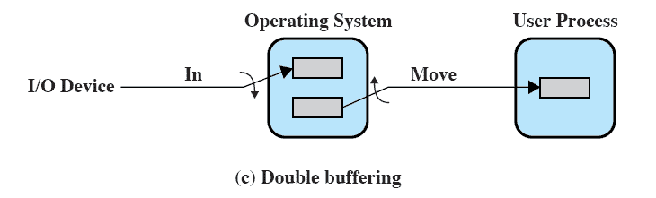
Double Buffer
Use two system buffers instead of one
A process can transfer data to or from one buffer while the operating system empties or fills the other buffer
Also known as buffer swapping
Notes:
An improvement over single buffering can be had by assigning two system buffers to
the operation ( Figure 11.5c ). A process now transfers data to (or from) one buffer
while the operating system empties (or fills) the other. This technique is known as
double buffering or buffer swapping .
For block-oriented transfer, we can roughly estimate the execution time as
max [ C , T ]. It is therefore possible to keep the block-oriented device going at full
speed if C … T . On the other hand, if C 7 T , double buffering ensures that the
process will not have to wait on I/O. In either case, an improvement over single
buffering is achieved. Again, this improvement comes at the cost of increased
complexity.
For stream-oriented input, we again are faced with the two alternative modes
of operation. For line-at-a-time I/O, the user process need not be suspended for
input or output, unless the process runs ahead of the double buffers. For byte-at-atime
operation, the double buffer offers no particular advantage over a single buffer
of twice the length. In both cases, the producer/consumer model is followed.

Slide 27
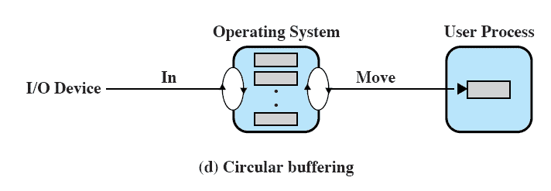
Circular Buffer
Two or more buffers are used
Each individual buffer is one unit in a circular buffer
Used when I/O operation must keep up with process
Notes:
A double-buffer scheme should smooth out the flow of data between an I/O device
and a process. If the performance of a particular process is the focus of our concern,
then we would like for the I/O operation to be able to keep up with the process.
Double buffering may be inadequate if the process performs rapid bursts of I/O. In
this case, the problem can often be alleviated by using more than two buffers.
When more than two buffers are used, the collection of buffers is itself referred
to as a circular buffer ( Figure 11.5d ), with each individual buffer being one unit in
the circular buffer. This is simply the bounded-buffer producer/consumer model
studied in Chapter 5 .

Slide 28



Technique that smoothes out peaks in I/O demand
  with enough demand eventually all buffers become full and their advantage is lost
When there is a variety of I/O and process activities to service, buffering can increase the efficiency of the OS and the performance of individual processes
Notes:
Buffering is a technique that smoothes out peaks in I/O demand. However, no
amount of buffering will allow an I/O device to keep pace with a process indefinitely
when the average demand of the process is greater than the I/O device can
service. Even with multiple buffers, all of the buffers will eventually fill up and the
process will have to wait after processing each chunk of data. However, in a multiprogramming
environment, when there is a variety of I/O activity and a variety of
process activity to service, buffering is one tool that can increase the efficiency of
the operating system and the performance of individual processes.

Slide 29
Disk Scheduling
The operating system is responsible for using hardware efficiently — for the disk drives, this means having a fast access time and disk bandwidth
Access time has two major components
  Seek time is the time for the disk are to move the heads to the cylinder containing the desired sector
  Rotational latency is the additional time waiting for the disk to rotate the desired sector to the disk head
Minimize seek time
Seek time ≈ seek distance
Disk bandwidth is the total number of bytes transferred, divided by the total time between the first request for service and the completion of the last transfer

Slide 30
Disk Scheduling (Cont.)
Several algorithms exist to schedule the servicing of disk I/O requests
We illustrate them with a request queue (0-199)
98, 183, 37, 122, 14, 124, 65, 67
Head pointer 53

Slide 31

FCFS
Illustration shows total head movement of 640 cylinders

Slide 32
SSTF
Selects the request with the minimum seek time from the current head position
SSTF scheduling is a form of SJF scheduling; may cause starvation of some requests
Illustration shows total head movement of 236 cylinders

Slide 33

SSTF (Cont.)

Slide 34
SCAN
The disk arm starts at one end of the disk, and moves toward the other end, servicing requests until it gets to the other end of the disk, where the head movement is reversed and servicing continues.
SCAN algorithm Sometimes called the elevator algorithm
Illustration shows total head movement of 208 cylinders

Slide 35

SCAN (Cont.)

Slide 36
C-SCAN
Provides a more uniform wait time than SCAN
The head moves from one end of the disk to the other, servicing requests as it goes
  When it reaches the other end, however, it immediately returns to the beginning of the disk, without servicing any requests on the return trip
Treats the cylinders as a circular list that wraps around from the last cylinder to the first one

Slide 37

C-SCAN (Cont.)

Slide 38
C-LOOK
Version of C-SCAN
Arm only goes as far as the last request in each direction, then reverses direction immediately, without first going all the way to the end of the disk

Slide 39

C-LOOK (Cont.)

Slide 40
Selecting a Disk-Scheduling Algorithm
SSTF is common and has a natural appeal
SCAN and C-SCAN perform better for systems that place a heavy load on the disk
Performance depends on the number and types of requests
Requests for disk service can be influenced by the file-allocation method
The disk-scheduling algorithm should be written as a separate module of the operating system, allowing it to be replaced with a different algorithm if necessary
Either SSTF or LOOK is a reasonable choice for the default algorithm

Slide 41

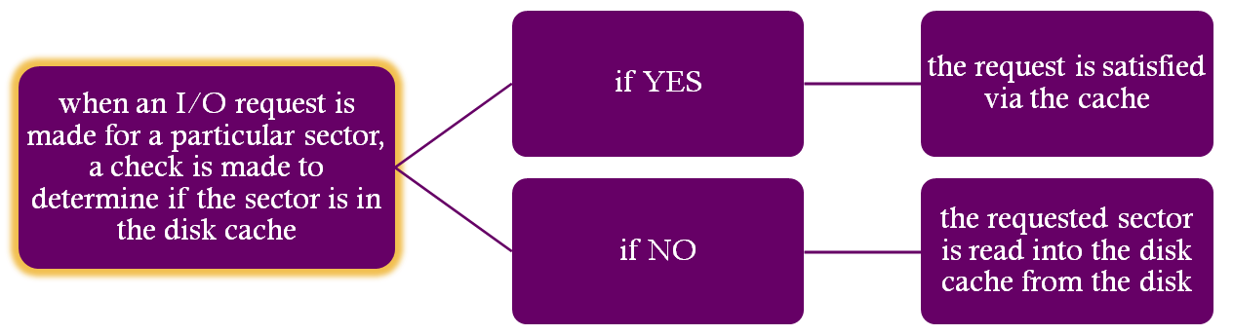
Cache memory is used to apply to a memory that is smaller and faster than main memory and that is interposed between main memory and the processor
Reduces average memory access time by exploiting the principle of locality
Disk cache is a buffer in main memory for disk sectors
Contains a copy of some of the sectors on the disk
Notes:
In Section 1.6 and Appendix 1A, we summarized the principles of cache memory.
The term cache memory is usually used to apply to a memory that is smaller and
faster than main memory and that is interposed between main memory and the
processor. Such a cache memory reduces average memory access time by exploiting
the principle of locality.
The same principle can be applied to disk memory. Specifically, a disk cache
is a buffer in main memory for disk sectors. The cache contains a copy of some of
the sectors on the disk. When an I/O request is made for a particular sector, a check
is made to determine if the sector is in the disk cache. If so, the request is satisfied
via the cache. If not, the requested sector is read into the disk cache from the disk.
Because of the phenomenon of locality of reference, when a block of data is fetched
into the cache to satisfy a single I/O request, it is likely that there will be future
references to that same block.

Slide 42


Most commonly used algorithm that deals with the design issue of replacement strategy
The block that has been in the cache the longest with no reference to it is replaced
A stack of pointers reference the cache
  most recently referenced block is on the top of the stack
  when a block is referenced or brought into the cache, it is placed on the top of the stack
Notes:
The most commonly used algorithm is least recently used (LRU)
Replace that block that has been in the cache longest with no reference to it.
The cache consists of a stack of blocks, with the most recently referenced block on the top of the stack.
When a block in the cache is referenced, it is moved from its existing position on the stack to the top of the stack.
When a block is brought in from secondary memory, remove the block that is on the bottom of the stack and push the incoming block onto the top of the stack.
It is not necessary actually to move these blocks around in main memory; a stack of pointers can be associated with the cache.

Slide 43


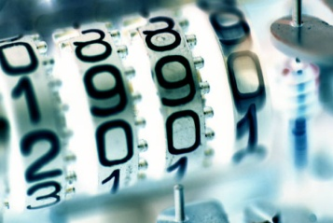
The block that has experienced the fewest references is replaced
A counter is associated with each block
Counter is incremented each time block is accessed
When replacement is required, the block with the smallest count is selected
Notes:
Another possibility is least frequently used (LFU) : Replace that block in the
set that has experienced the fewest references. LFU could be implemented by associating
a counter with each block. When a block is brought in, it is assigned a count
of 1; with each reference to the block, its count is incremented by 1. When replacement
is required, the block with the smallest count is selected. Intuitively, it might
seem that LFU is more appropriate than LRU because LFU makes use of more
pertinent information about each block in the selection process.
A simple LFU algorithm has the following problem. It may be that certain
blocks are referenced relatively infrequently overall, but when they are referenced,
there are short intervals of repeated references due to locality, thus building up
high reference counts. After such an interval is over, the reference count may be
misleading and not reflect the probability that the block will soon be referenced
again. Thus, the effect of locality may actually cause the LFU algorithm to make
poor replacement choices.

Slide 44
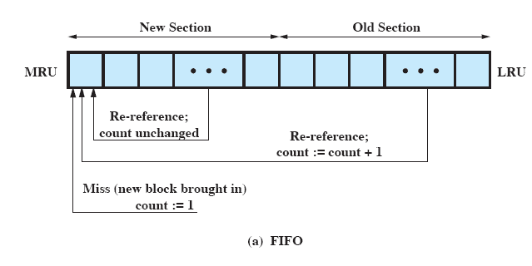
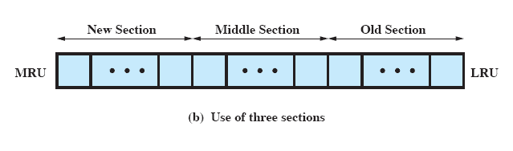
Frequency-Based Replacement
Notes:
To overcome this difficulty with LFU, a technique known as frequency-based
replacement is proposed in [ROBI90]. For clarity, let us first consider a simplified
version, illustrated in Figure 11.9a . The blocks are logically organized in a stack, as
with the LRU algorithm. A certain portion of the top part of the stack is designated
the new section. When there is a cache hit, the referenced block is moved to the top
of the stack. If the block was already in the new section, its reference count is not
incremented; otherwise it is incremented by 1. Given a sufficiently large new section,
this results in the reference counts for blocks that are repeatedly re-referenced
within a short interval remaining unchanged. On a miss, the block with the smallest
reference count that is not in the new section is chosen for replacement; the least
recently used such block is chosen in the event of a tie.
The authors report that this strategy achieved only slight improvement over
LRU. The problem is the following:
1. On a cache miss, a new block is brought into the new section, with a count of 1.
2. The count remains at 1 as long as the block remains in the new section.
3. Eventually the block ages out of the new section, with its count still at 1.
4. If the block is not now re-referenced fairly quickly, it is very likely to be
replaced because it necessarily has the smallest reference count of those blocks
that are not in the new section. In other words, there does not seem to be a
sufficiently long interval for blocks aging out of the new section to build up
their reference counts even if they were relatively frequently referenced.
A further refinement addresses this problem: Divide the stack into three
sections: new, middle, and old ( Figure 11.9b ). As before, reference counts are not
incremented on blocks in the new section. However, only blocks in the old section
are eligible for replacement. Assuming a sufficiently large middle section, this allows
relatively frequently referenced blocks a chance to build up their reference counts
before becoming eligible for replacement. Simulation studies by the authors indicate
that this refined policy is significantly better than simple LRU or LFU.
Regardless of the particular replacement strategy, the replacement can take
place on demand or preplanned. In the former case, a sector is replaced only when
the slot is needed. In the latter case, a number of slots are released at a time. The
reason for this latter approach is related to the need to write back sectors. If a sector
is brought into the cache and only read, then when it is replaced, it is not necessary
to write it back out to the disk. However, if the sector has been updated, then it is
necessary to write it back out before replacing it. In this latter case, it makes sense
to cluster the writing and to order the writing to minimize seek time.

Slide 45
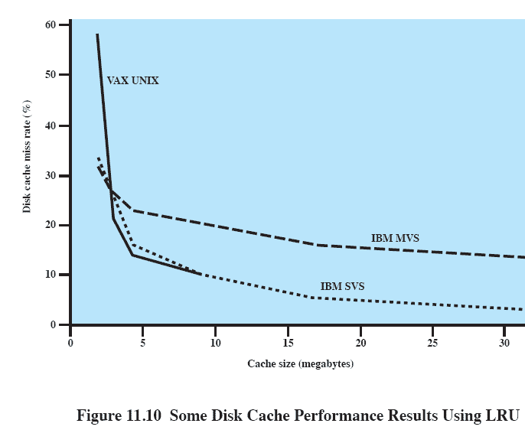
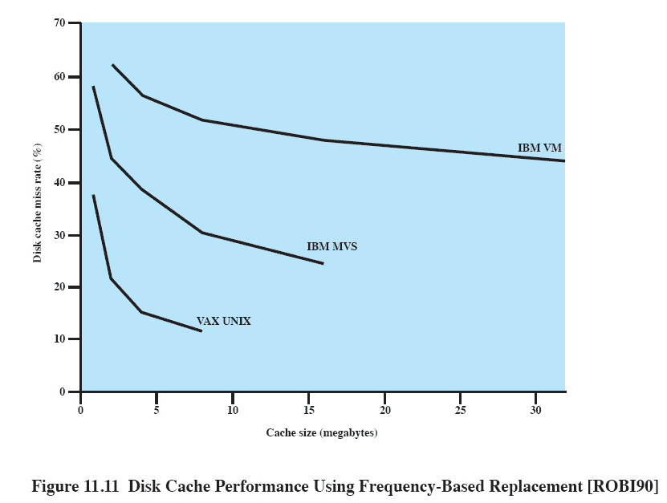
Disk Cache
Performance
Frequency-Based
Replacement
LRU
Notes:
The same performance considerations discussed in Appendix 1A apply here. The
issue of cache performance reduces itself to a question of whether a given miss ratio
can be achieved. This will depend on the locality behavior of the disk references,
the replacement algorithm, and other design factors. Principally, however, the miss
ratio is a function of the size of the disk cache. Figure 11.10 summarizes results from
several studies using LRU, one for a UNIX system running on a VAX [OUST85]
and one for IBM mainframe operating systems [SMIT85]. Figure 11.11 shows results
for simulation studies of the frequency-based replacement algorithm. A comparison
of the two figures points out one of the risks of this sort of performance assessment.
The figures appear to show that LRU outperforms the frequency-based replacement
algorithm. However, when identical reference patterns using the same cache
structure are compared, the frequency-based replacement algorithm is superior.
Thus, the exact sequence of reference patterns, plus related design issues such as
block size, will have a profound influence on the performance achieved.

